Slide 1

Welcome
Global health
Session 7
Dr. Tilly Paz

Slide 2

In this session you will:
Understand the main women’s health issues on a global level
Work with case studies that focus on CDs and NCDs of women around the world

Slide 3
The Importance of Women’s Health
Women face a number of unique health problems
Poor health of women can have enormous consequences on society
The health of children depends in many ways on the health of their mothers
Women’s health is linked closely with the SDGs
Notes:
Which is the most important in your opinion?

Slide 4
Key Definitions
Abortion: the premature expulsion or loss or embryo, which may be induced or spontaneous
Sex-selective abortion: the practice of aborting a fetus after a determination that the fetus is an undesired sex, typically female
Hemorrhage: significant and uncontrolled loss of blood, either internally or externally from the body
Maternal death: the death of a woman while pregnant, during delivery, or within 42 days of delivery
Caesarean delivery (section): the surgical delivery of a fetus through abdominal incision
Female genital mutilation: traditional practices that are all related to the cutting of the female genital organs

Slide 5
Some Key Differences Between the Health of Men and Women
An analysis identified 19 conditions that disproportionately affect women
They are specific to women, related to women’s higher life expectancy, or are a result of gender discrimination
Alzheimer’s disease is a higher ranked cause of death for females than males
Higher rate of dietary iron deficiency among females

Slide 6
The Determinants of Women’s Health
Biological Determinants
Iron deficiency anemia related to menstruation
Complications of pregnancy
Increased susceptibility to some STIs
Health conditions, such as ovarian cancer, specific to women for biological reasons
Notes:
Think of examples that link these biological determinants to women’s mental health.
Find out a few facts about period poverty.

Slide 7
The Determinants of Women’s Health
Social Determinants
Male preference is sometimes expressed through female abortion or infanticide
Young female children often fed less nutritious food than male children, which can have long-term effects
Low social status linked to physical and sexual abuse and also depression
Household roles can lead to women cooking with poor ventilation indoors, associated with respiratory disease
Poverty, lack of or low levels of education, and low social status limit access to health care
Notes:
Which one is the most important in your opinion? Why?

Slide 8
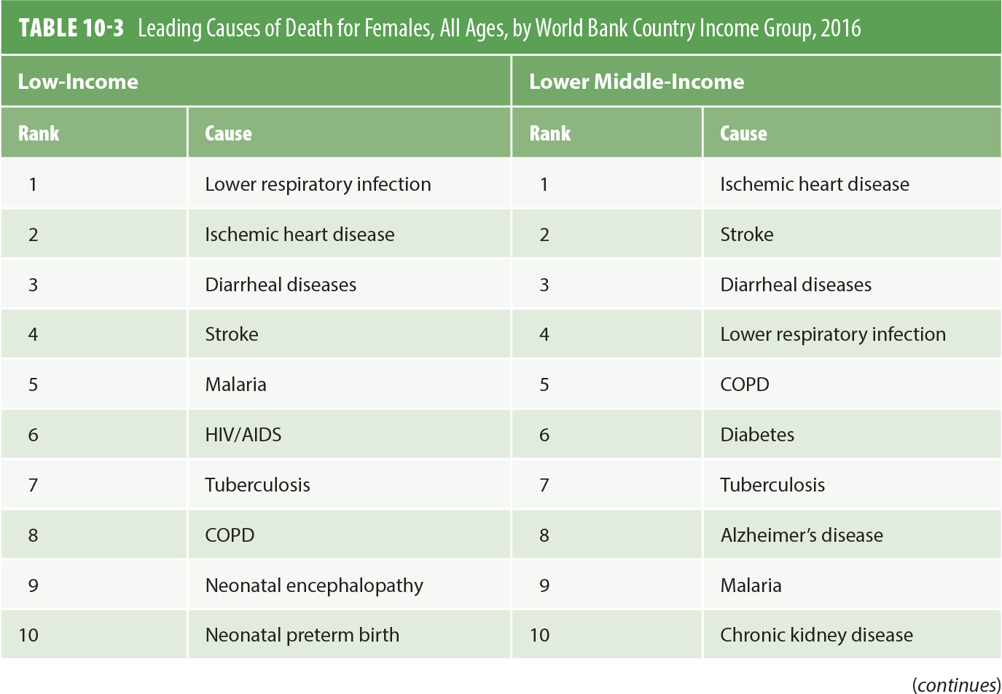
The Burden of Health Conditions for Females
Notes:
How many are CDs and how many are NCDs in each one of the categories? How do they rank in each category? Why is it the case?

Slide 9
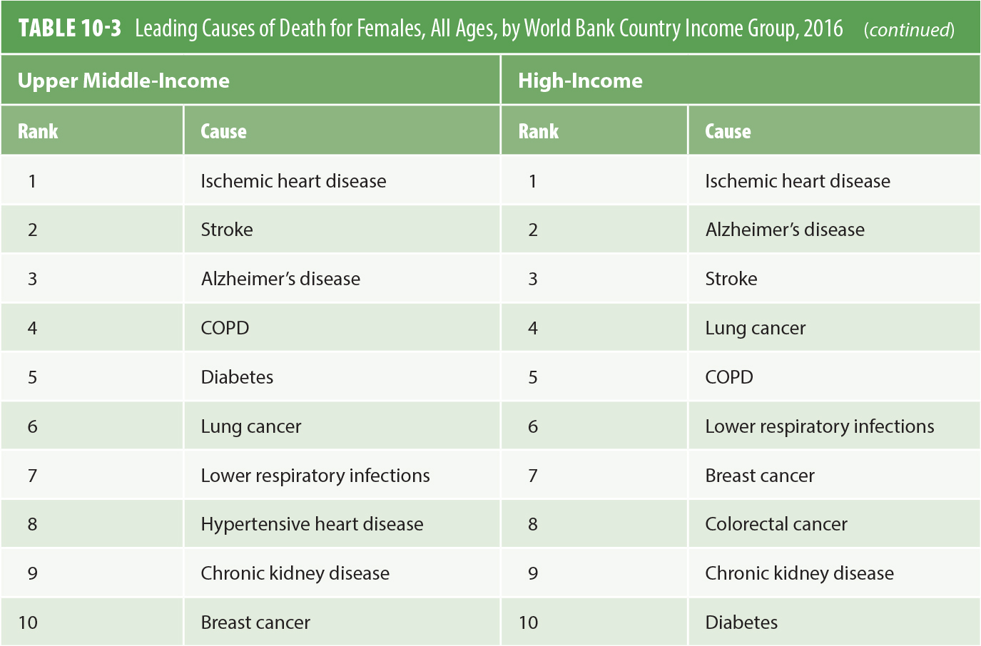
The Burden of Health Conditions for Females
Data from Institute of Health Metrics and Evaluation (IHME). (n.d.). GBD Compare: Viz Hub. Retrieved from https://vizhub.healthdata.org/gbd-compare/
Notes:
Can you spot any NCDs?
Can you guess why the order of mostly the same diseases is different?

Slide 10
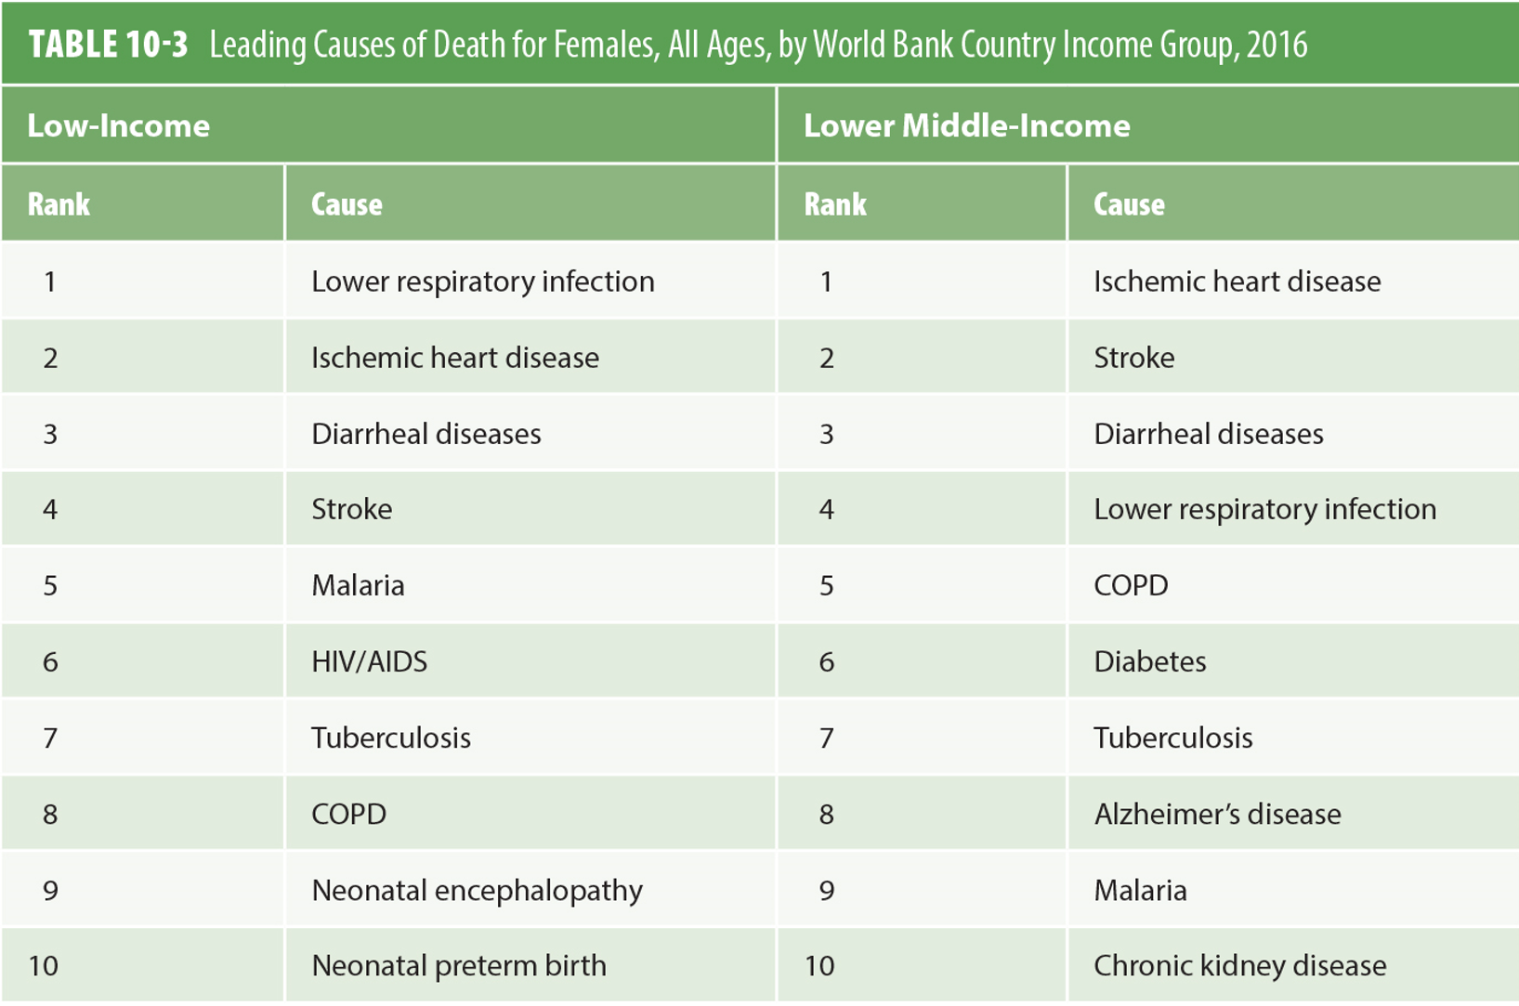
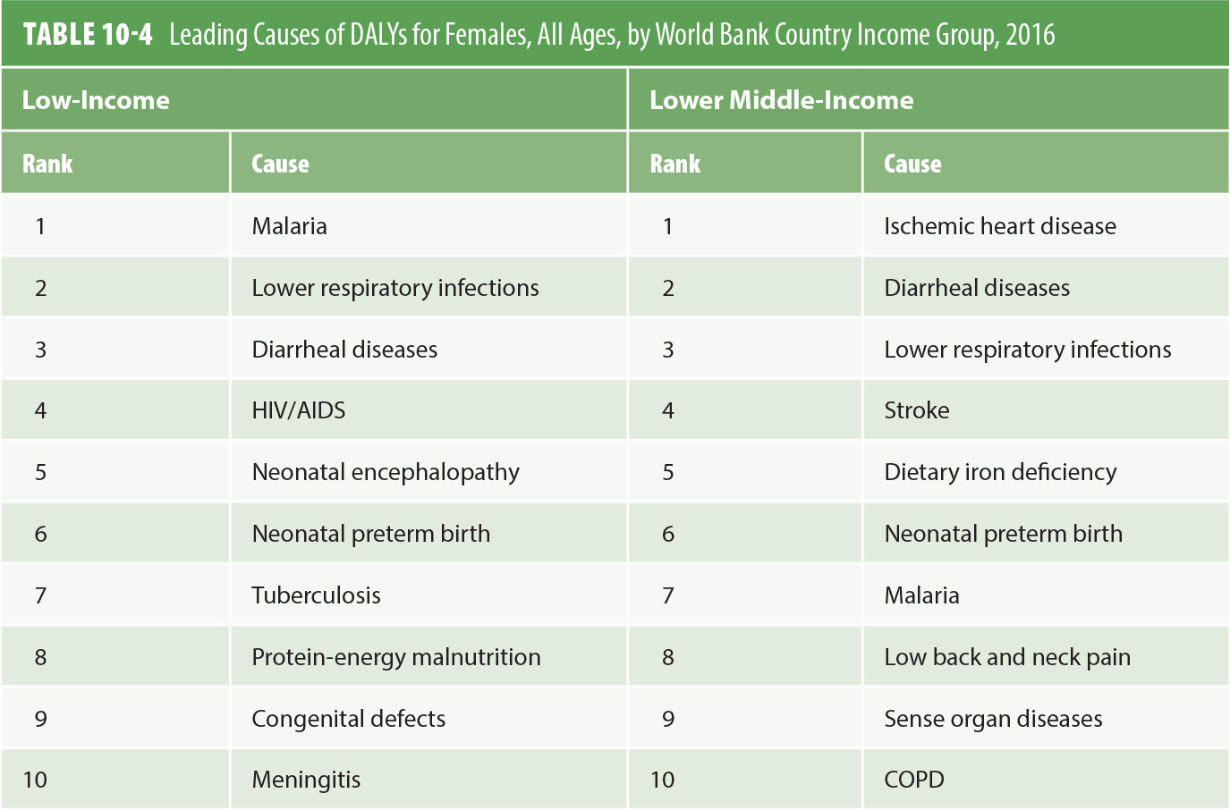
The Burden of Health Conditions for Females
Notes:
What are the differences between table 10-3 and 10-4 (death cases V. DALYs)? What may be the reason?

Slide 11
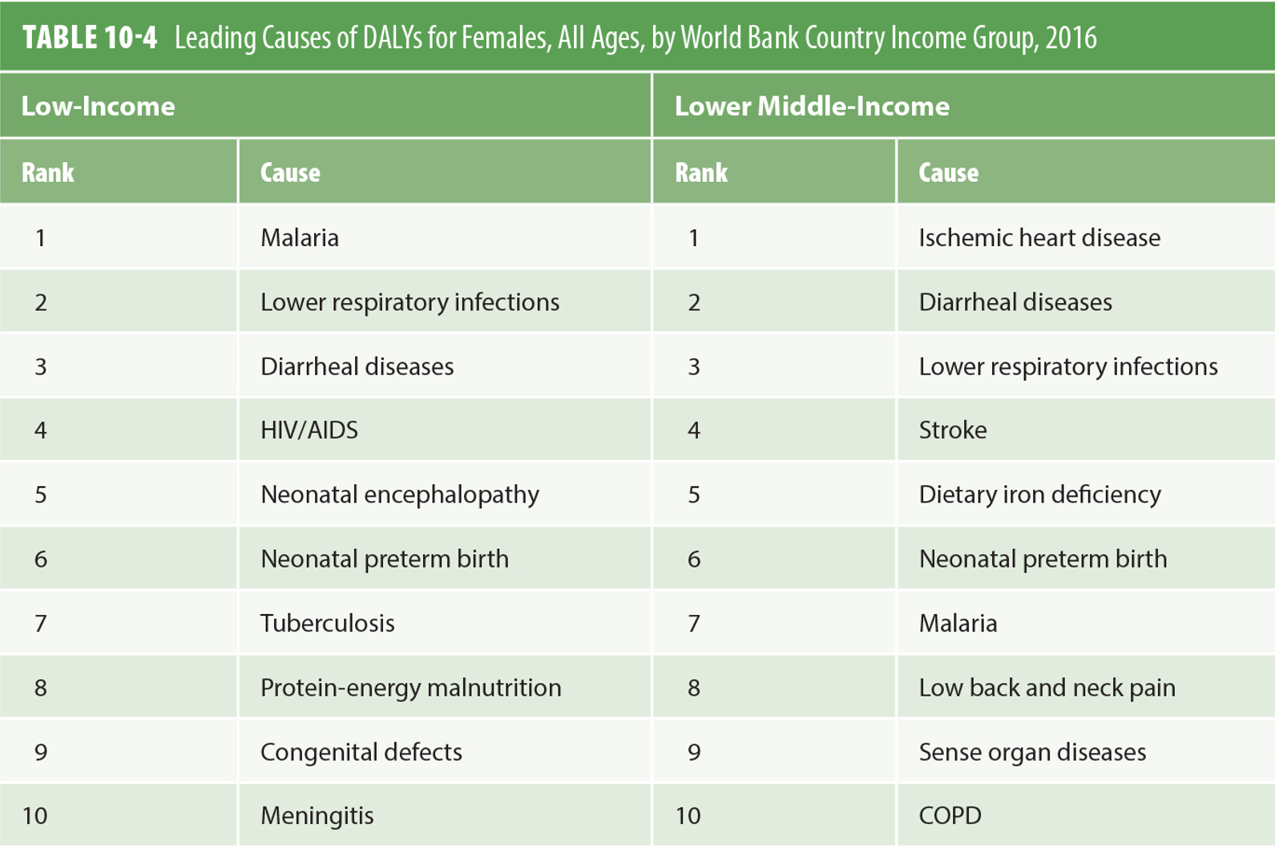
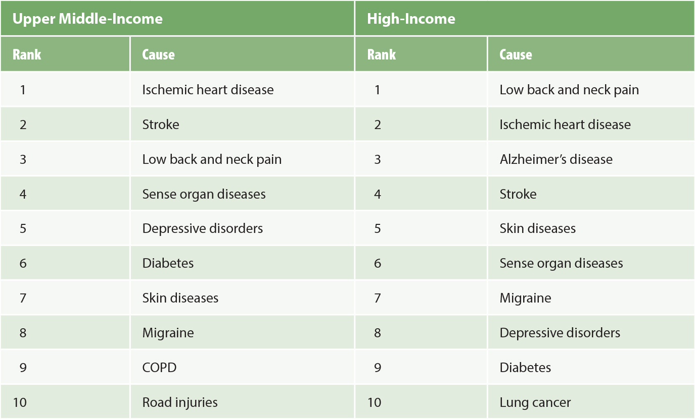
The Burden of Health Conditions for Females
Data from Institute of Health Metrics and Evaluation (IHME). (n.d.). GBD Compare: Viz Hub. Retrieved from https://vizhub.healthdata.org/gbd-compare/
Notes:
What are the differences between low/lower middle income countries and upper-middle/high income countries?
How can you explain that?

Slide 12
The Burden of Health Conditions for Females
Sex-Selective Abortion
Skewed ratios of males to females in some countries
India: 900 females born for every 1,000 males
China: 870 females born for every 1,000 males
Notes:
How does that affect women’s health?
Think of the physical as well as the mental health issues

Slide 13
The Burden of Health Conditions for Females
Female Genital Mutilation (FGM)
Estimated 200 million females worldwide have had some form of genital cutting
Very closely related to ethnicity
Practice appears to be diminishing
Can initially cause shock, infection, or hemorrhaging
Long-term problems include retention of urine, infertility, and obstructed labor
Notes:
How does it affect the mental health of women? And of the larger society?

Slide 14
The Burden of Health Conditions for Females
Sexually Transmitted Infections (STIs)
Women are biologically more susceptible
Risk factors for women include young age, sex with high-risk partners, and inability to negotiate condom use
There are an estimated 530,000 cases of HPV a year that cause about 270,000 cervical cancer deaths a year

Slide 15
The Burden of Health Conditions for Females
Violence and Sexual Abuse Against Women
UNAIDS estimates 10–50% of women worldwide have been abused physically by a partner
Can lead to injuries, unwanted pregnancy, STIs, depression, disability, and death
Risk factors include low socioeconomic status, young age of the male partner, and gender inequality
Notes:
How does it affect the health of women who have NOT been abused?
How does it affect the health of children in the family?

Slide 16
The Burden of Health Conditions for Women
Maternal Morbidity and Mortality
About 300,000 maternal deaths annually
Almost 60% of all maternal deaths occur in 10 countries: India, Nigeria, Pakistan, Indonesia, Tanzania, Kenya, Bangladesh, Uganda, Ethiopia, and the Democratic Republic of the Congo
Birth is the time of greatest risk for mother and baby

Slide 17
The Burden of Health Conditions for Women
Maternal Morbidity and Mortality
Twenty percent of maternal deaths are from obstructed labor and indirect causes, 80% are from direct causes
A woman in a high-income country has only a 1:3,300 chance of dying a maternal death, compared to 1:36 chance for a women in Sub-Saharan Africa

Slide 18
The Burden of Health Conditions for Women
Unsafe Abortion
Safe abortions are performed “by trained healthcare providers, with proper equipment, technique, and sanitary standards”
Only about 55% of abortions are safe
Unsafe abortions are associated with 13% of maternal deaths
There are about 25 million unsafe abortions each year
Notes:
Why do you think that we have so many unsafe abortions?

Slide 19
Addressing Future Challenges
Enhancing health of women in low- and middle-income countries will require a multifaceted approach that includes:
Enhancement of nutritional status
Cost-effective approaches to reducing the burden of communicable disease
Greater access to family planning, quality prenatal care, and quality obstetric care
Addressing the leading causes of disability and death that go beyond reproductive health

Slide 20
Addressing Future Challenges
Female Genital Mutilation
Efforts that promote change need to be specifically tailored to local practices and beliefs
Promote female empowerment, education, and control over economic resources

Slide 21
Addressing Future Challenges
Violence Against Women
Limited evidence overall about what works
Protect women through legislation
Provide shelters for abused women
Ensure police, judges, and healthcare workers are trained in effective methods
Promote community-based change of norms

Slide 22
Addressing Future Challenges
Sexually Transmitted Infections (STIs)
Focus on prevention
Need high-quality surveillance of STIs
Promote health education
Train health workers to provide proper treatment of infection
Establish a system of partner notification
Ensure access to health services

Slide 23
Addressing Future Challenges
Family Planning
Studies show that women in regions like SSA would like to avoid pregnancy but do not have needed access to family planning
Delaying the age at first birth, increasing birth intervals and reducing the number of births
Family planning is a cost-effective investment to reduce maternal morbidity and mortality
Notes:
Look back at slides 19-23
Which of the ideas are linked to empowerment?
Which are easier to implement and why?
Which are very hard to implement and why?

Slide 24
Main Messages
Health of females is a reflection of biological susceptibility and gender norms
Health of females also reflects gender gaps in health systems
Improving health of females, especially in low-income countries, will require social and public health measures

Slide 25
Main Messages
In low-income countries, communicable diseases such as HIV/AIDS, TB, malaria, and maternal causes continue to be leading causes of death of females (ages 15-49)
In middle-income countries, noncommunicable disease and injury rise as leading causes of death of females (ages 15-49)
In high-income countries, self-harm, drug-use disorders, road injuries, and ischemic heart disease are leading causes of death among females (ages 15-49)

Slide 26
Main Messages
Violence against women is also a central cause of ill health for women
About 300,000 women die each year of maternal causes; about 40,000 are due to unsafe abortions
Complicated labor if not properly attended to and can lead to problems, such as obstetric fistula, from which an estimated 2 million women suffer worldwide
STIs are an important cause of DALYs for women, especially in SSA
FGM is associated with important morbidity and disability for women

Slide 27
Main Messages
Improving the health status of females will require attention to nutrition, sex-selective abortion, and discriminatory healthcare practices (toward young girls)
There is an unmet demand for access to family planning
Maternal morbidity and mortality have substantial economic implications

Slide 28
Main Messages
Implementing quality packages that address communicable and noncommunicable disease burdens are critical to addressing women’s health
Package components include: Enhancement of nutritional status of women; Access to quality family planning, and prenatal and obstetric care; Efforts to reduce hypertension and diabetes; Cost-effective interventions for secondary prevention of heart disease and stroke

Slide 29
Main Messages
Poverty, lack of or low levels of education, and low social status limit access to health care
Efforts that promote change need to be specifically tailored to local practices and beliefs
Promote female empowerment, education, and control over economic resources
Notes:
Look back at slides 24-29
If you had to choose just one main message to deliver in a big women’s conference – which one would it be and why?

Slide 30

See you next week
Bring your printed essay plan, ready for reflection and submission
Wait for the email and follow the instructions

